Slide 1
VHDL Overview
A Quick Start Tutorial

Slide 2
What does VHDL stand for ?
VHSIC Hardware Description Language
VHSIC: Very High Speed Integrated Circuits

Slide 3
There are many HDLs …
VHDL USA Department of Defense IEEE Std 1076-1993
Verilog IEEE Std 1364-1995
Super Verilog
SystemC
SpecC
…
HW & SW

Slide 4
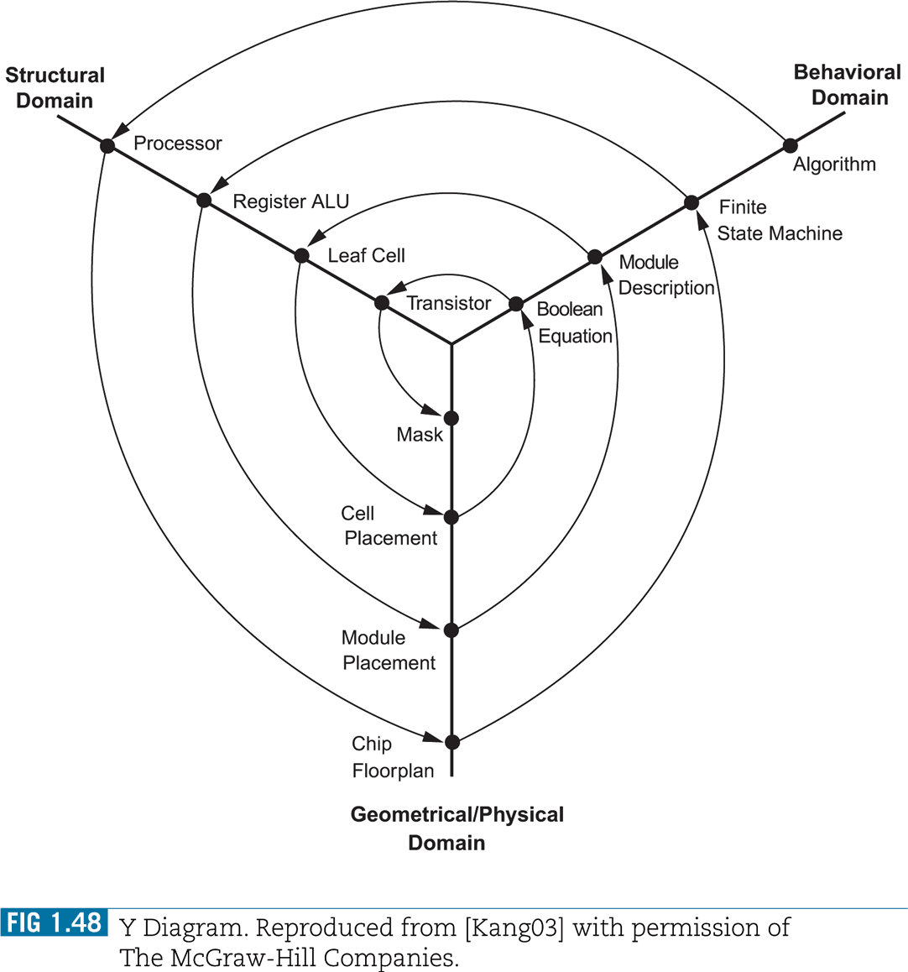
The Y-Diagram Design Paradigm
Design is structured around a hierarchy of representations
HDLs can describe distinct aspects of a design at multiple levels of abstraction

Slide 5
Levels of Abstraction
RTL
SW
RTL
System Level
Abstraction
RT Level (Module)
Gate Level
Circuit Level
1970
1980
1990
2000+

Slide 6
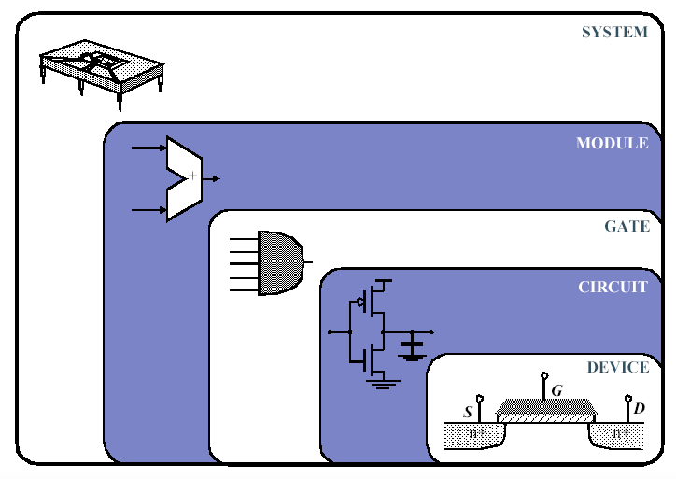
Design Abstraction Levels

Slide 7
Role of HDLs
V
Very High Speed Integrated Circuit
H
Hardware
D
Description
L
Language
System description and documentation
System simulation
System synthesis

Slide 8
Role of HDLs
Design Specification
unambiguous definition of components, functionality and interfaces
Design Simulation
verify system/subsystem performance and functional correctness prior to design implementation
Design Synthesis
automated generation of a hardware design

Slide 9
HDL Benefits
Technology independence
portability
Reuse
Interoperability between multiple levels of abstractions
Cost reduction
Higher Level of Abstraction (hiding details)
The design task become simpler
The design is less error prone
Productivity is increased

Slide 10
HDL coding Styles
Register Transfer Level
Structural
Behavioral
Be careful NOT
everybody gives
the same meaning to
the term BEHAVIORAL !

Slide 11


RTL
model combinational and sequential logic components
Only a small subset of the Language statements can be mapped in real “Silicon”.
area and timing
constraints
generic
technology
target
technology
unoptimized
generic
boolean netlist
optimization & mapping
optimized
gate level
netlist
HDL code
translation
SYNTHESIS

Slide 12
Structural Level
Describe connectivity among components
The code consists of a bunch of port mappings.

Slide 13
Behavioral Level
Describe behavior (functionality and performances)
All language features can be used

Slide 14
Levels of Abstraction
High
Intermediate
Low
Behavioral RTL Structural

Slide 15
HDL style vs. application
High Level Modeling (Behavioral style)
Design Entry (Structural & RTL styles)
Simulation (Behavioral style)
validation by mean of a test bench
dut_tb.vhd
dut.vhd
instantiate
design to
test
generate stimuli
observe
responses
TESTBENCH

Slide 16
Modeling Digital Systems
abstraction Levels
What aspects do we need to consider to describe a digital system ?
Interface
Function
Performance (delay/area/costs/…)

Slide 17
Modeling Digital Systems
What are the attributes necessary to describe a digital systems ?
events, propagation delays, concurrency
waveforms and timing
signal values
shared signals

Slide 18
Modeling Digital Systems
Hardware description languages must provide constructs for describing the attributes of a specific design, and …
Simulators use such descriptions for “mimicking” the physical system behavior
Synthesis compilers use such descriptions for synthesizing manufacturable hardware that conform to a given specification

Slide 19
HDLs vs. Software Languages
Concurrent (parallel) Statements vs. Sequential Statements

Slide 20
VHDL Design Organization
Entity the “symbol” (input/output ports)
Architecture one of the several possible implementation of the design
Configuration binding between the symbol and one of the many possible implementation. Can be used to express hierarchy.

Slide 21
VHDL Design Organization
Libraries logical units that are mapped to physical directories. The units of a library are called packages.
Packages repositories for type definitions, procedures, and functions
Libraries and packages can be system defined or user defined

Slide 22
Design Units
Primary design units (not dependent on other design units)
Entity
Configuration
Package Declaration
Secondary design units
Package body
Architecture
Design units are arranged in files
Now you know the layout of a VHDL program!

Slide 23
Entity
entity mux is
port ( a: in std_logic; b: in std_logic;
s: in std_logic; f: out std_logic )
end mux;
MUX
A
B
F
S

Slide 24
Architecture #1
architecture first_rtl of mux is
begin
mux_p: process (a,b,s)
begin f <= (a and s) or (b and not s); end process mux_p;
end first_rtl;

Slide 25
Architecture #2
architecture rtl of mux is
begin
mux_p: process (a,b,s)
begin if (s=‘1’) then f <= a;
else f <= b; end if;
end process mux_p;
end rtl;

Slide 26
Configuration
configuration mux_c of mux is for rtl end for;
end mux_c;

Slide 27
Where did we get std_logic ?
Ohps !!! We need to include some library before we can use this predefined data type
library ieee; use ieee.std_logic_1164.all; use ieee.std_logic_arith.all;

Slide 28
Predefined data types
bit: ‘0’ , ‘1’
boolean: false, true
integer: from negative 2³¹-1 to positive 2³¹-1
std_ulogic: ‘1’,’0’,’H’,’L’,’X’,’U’,’Z’,’-’,’W’
std_logic: ‘1’,’0’,’H’,’L’,’X’,’U’,’Z’,’-’,’W’

Slide 29
std_logic, and std_ulogic
‘1’, ’0’, ’X’ → logic 1, logic 0, unknown
‘H’, ’L’, ’W’ → weak 1, weak 0, weak unknown
‘U’, ‘Z’, ‘-’ → uninitialized, high impedance, don’t care

Slide 30
resolved or unresolved ?
VHDL Driver – it is one contributor to the final value of a signal
Drivers are created by concurrent signal assignments
Recommendation: use std_logic, but always check that you do not have any multiple drivers (you don’t want any wired OR inside an ASIC !!!)

Slide 31
What is a process ?
A process statement is a concurrent statement, but all statements contained in it are sequential statement (statements that executes serially, one after the other).
The use of processes makes your code more modular, more readable, and allows you to separate combinational logic from sequential logic.

Slide 32
The sensitivity list
List of all signals that the process is sensitive to. Sensitive means that a change in the value of these signals will cause the process to be invoked.

Slide 33
For combinational logic the sensitivity list must be complete !!!
process (a)
variable a_or_b;
begin
a_or_b := a or b;
z <= a_or_b;
end process;
-- since b is not in the
-- sensitivity list, when
-- a change occurs on b
-- the process is not
-- invoked, so the value
-- of z is not updated
-- (still “remembering” the
-- old value of z)

Slide 34
Incomplete sensitivity list effect
a
b
z
(VHDL)
z
(gate level)

Slide 35
What to put in sensitivity list ?
All signals you do a test on and all signals that are on the right side of an assignment.
In other words all the signals you are “reading” in the value
Don’t read and write a signal at the same time !!!

Slide 36
VHDL Object Types
Constants
Signals
Variables
Files

Slide 37
Constant
You can think of it just as a name for a value reset_c := ‘0’; bus_width_c := 32;
The value assigned to a constant cannot be changed (the location of memory that stores the value cannot be modified)
Benefits:
a better documented design.
it is easier to update the design.
But do not exaggerate !!! since you’ll have to remember all these names you defined !

Slide 38
Signals
It is a physical signal (you can think of it like a piece of wire)
A signal is a sequence of time-value pairs
A signal assignment takes effect only after a certain delay (the smallest possible delay is called a “delta time”).
It is possible to define global signals (signals that can be shared among entities)
But more often signals are just locally defined for a given architecture

Slide 39
Variables
Assignment to variables are scheduled immediately (the assignment takes effect immediately)
If a variable is assigned a value, the corresponding location in memory is written with the new value while destroying the old value.
This effectively happen immediately so if the next executing statement in the program uses the value of the variable, it is the new value that is used.
Typically, variables are used as a local storage mechanism, visible only inside a process

Slide 40
Signals vs. Variables
Signals assignments are scheduled after a certain delay δ
Variables assignments happen immediately, there is no delay

Slide 41
Signals vs. Variables
In1
s1
s3
z
In2
s4
s2
library IEEE;
use IEEE.std_logic_1164.all;
entity combo is
port (In1, In2: in std_logic;
z : out std_logic);
end entity combo;
architecture rtl of combo is
variable s1, s2, s3, s4: std_logic;
begin
sig_in_proc: process (In1, In2) is
begin
s1 := not In1;
s2 := not In2;
s3 := not (s1 and In2);
s4 := not (s2 and In1);
z <= not (s3 and s4);
end process sig_in_proc;
end architecture rtl;
Use variables for computing
intermediate values

Slide 42
Signals vs. Variables
-- Process 1 – Correct Coding Style
proc1: process (x, y, z) is
variable var_s1, var_s2: std_logic;
begin
var_s1 := x and y;
var_s2 := var_s1 xor z;
res1 <= var_s1 nand var_s2;
end process;
Process 2 – Incorrect
proc2: process (x, y, z) is
begin
sig_s1 <= x and y;
sig_s2 <= sig_s1 xor z;
res2 <= sig_s1 nand sig_s2;
end process;
signals
variables

Slide 43
Delta Time
architecture rtl of logic is
signal a_or_b : std_logic;
begin
a_or_b <= a or b; -- a_or_b is scheduled @ t+Δ
z <= a_or_b and c; -- z is scheduled @ t+2Δ
end rtl;
NOTE: Here the two statements are concurrent (they are not embedded in a process)

Slide 44
Bad coding example: Delta time issues !!!
architecture bad of logic is
signal a_or_b : std_logic;
begin
logic_p: process(a,b,c)
begin
a_or_b <= a or b;
z <= a_or_b and c;
end process;
end bad;
write
Do not “read” and “write”
a signal at the same time !!!
read

Slide 45
How to fix the bad coding example
architecture good of logic is
variable a_or_b : std_logic;
begin
logic_p: process(a,b,c)
begin
a_or_b := a or b;
z <= a_or_b and c;
end process;
end good;

Slide 46
Packages
Packages offers a mechanism to globally define and share values, types, components, functions and procedures that are commonly used.
package declaration and package body

Slide 47
Subprograms
Procedures can return more than one value (they can have both input and output parameters)
Functions return always just one value (can have only input parameters) Example: conversion functions, resolution functions, …

Slide 48
Attributes
Info attached to VHDL objects
Some predefined attributes: ‘left → the leftmost value of a type ‘right ‘high → the greatest value of a type ‘low ‘length → the number of elements in an array ‘event → a change on a signal or variable ‘range → the range of the elements of an array object

Slide 49
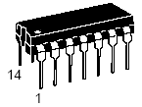

Component (socket mechanism)
Declare the name and interface of a “sub-unit”, to be used in the current level of design hierarchy. component adder port ( in_a, in_b: in std_logic_vector; z : std_logic_vector; carry: std_logic); end component;
adder
adder
instance #1
adder
instance #2

Slide 50
Elements of structural models
Structural models describe a digital system as an interconnection of components
An entity/architecture for each component must be independently available

Slide 51
Structural models
Structural models are always “built” as follows:
Define the components used in the design
Describe the interconnection of these components
Structural models can be easily generated (automatically) from schematics
Structural descriptions can be nested

Slide 52
Hierarchy and Abstraction
Structural modeling expresses the hierarchical nature of designs and provides a mechanism for the instantiation and reuse of cores

Slide 53
An example of structural modeling (1)
shift_1
Clk
Clk
Q_net
Rst
Rst
Q
Load
Load
Qb
Init
Data
shifter
comp_1
A
EQ
Limit
Test
B
compare
shiftcomp

Slide 54
An example of structural modeling (2)
library ieee;
use ieee.std_logic_1164.all;
entity shiftcomp is port(
Clk, Rst, Load: in std_logic;
Init: in std_logic_vector(0 to 7);
Test: in std_logic_vector(0 to 7);
Limit: out std_logic);
end shiftcomp;

Slide 55
An example of structural modeling (3)
architecture structure of shiftcomp is
component compare
port(A, B: in std_logic_vector(0 to 7); EQ: out std_logic);
end component;
component shifter
port(Clk, Rst, Load: in std_logic;
Data: in std_logic_vector(0 to 7);
Q: out std_logic_vector(0 to 7);
Qb: out std_logic_vector(0 to 7));
end component;
signal Q_net: std_logic_vector(0 to 7);
begin
COMP_1: compare port map (A => Q_net, B => Test, EQ => Limit);
SHIFT_1: shifter port map (Clk => Clk, Rst => Rst,
Load => Load, Data => Init,
Q => Q_net, Qb => open);
end structure;

Slide 56
An example of structural modeling (4)
-- 8-bit barrel shifter
library ieee;
use ieee.std_logic_1164.all;
entity shifter is
port(
Clk, Rst, Load: in std_logic;
Data: in std_logic_vector(0 to 7);
Q: out std_logic_vector(0 to 7);
Qb: out std_logic_vector(0 to 7)
);
end shifter;
architecture rtl of shifter is
begin
reg: process(Rst,Clk)
variable Qreg: std_logic_vector(0 to 7);
begin
if Rst = '1' then -- Async reset
Qreg := "00000000";
elsif rising_edge(Clk) then
if Load = '1' then
Qreg := Data;
else
Qreg := Qreg(1 to 7) & Qreg(0);
end if;
end if;
Q <= Qreg;
Qb <= not(Qreg);
end process;
end rtl;

Slide 57
An example of structural modeling (5)
-- Eight-bit comparator
library ieee;
use ieee.std_logic_1164.all;
entity compare is
port( A, B: in std_logic_vector(0 to 7);
EQ : out std_logic);
end compare;
architecture rtl of compare is
begin
EQ <= ‘1’ when (A = B) else ‘0’;
end rtl;

Slide 58
ASSERT statement
The ASSERT checks a boolean expression and if the value is true does nothing, else will output a text string to std output. It can have different severity levels: NOTE, WARNING, ERROR, FAILURE ASSERT false REPORT “End of TestBench” SEVERITY ERROR;

Slide 59
COMPLEX TYPES:
enumerated types TYPE color is (red, blue, yellow, green)
ARRAY TYPE dbus is ARRAY (31 downto 0) of std_logic

Slide 60
COMPLEX TYPES:
RECORD TYPE instruction is RECORD opcode: integer; src: integer; dest: integer; END RECORD

Slide 61
COMPLEX TYPES:
FILE TYPE ram_data_file_t IS FILE OF INTEGER; FILE ram_data_file : ram_data_file_t IS IN “/claudio/vhdl/tb/ram.txt”

Slide 62
More on FILEs
use std.textio.all;
READ, WRITE, READLINE, WRITELINE, ENDFILE, …

Slide 63
Advanced Topics
VHDL supports overloading

